Slide 1

Epileptic Seizure Prediction Using Intracranial Brain Records (EEG)
Group Members:
Pranav Karnani
Awais Mullah
Adarsh Pandey
Project Guide:
Amarja Ma’am
hankar

Slide 2
Problem Statement
For many people with epilepsy, seizures occur at random times and greatly disrupt their cognitive and emotional state, their ability to work and drive, and their social and economic situation. Being able to predict epileptic seizures will greatly improve the quality of life of people with epilepsy by either giving them a warning of an impending seizure so they can move to safety or activating an implanted seizure control device that can avert seizures through drug delivery or electrical stimulation of the brain. How can we forecast epileptic seizures using electrical recordings of brain activity?

Slide 3
Objectives
To develop an automated, deep-learning neural network system for seizure forecasting using intracranial Electroencephalograms (iEEG).
To provide well performed and reliable system across patients without regular maintenance and reconfiguration.
To design a real-time forecasting model with the inherent risks, since patients may have different needs and alternative settings of the system.
To allow the patients or clinicians to be able to prioritize or estimates high sensitive or low time in caution according to their requirements and to provide improved usefulness of seizure system.

Slide 4
Scope:
Improved preprocessing of Intracranial Electroencephalograms (iEEG) signal to receive increased sensitivity of seizure.
Detecting the appearance of preictal state, the state before the seizure begins using neural network model.
This model approaches high-level representation and efficiently distinguish between normal and epileptic actions of the brain with robustness and accuracy.

Slide 5
Model Decisions
Data Acquisition and Preprocessing:
The data used here consists of 11500 patients data.
Each patient has been recorded of their scalp for about 178 time units and that’s why we see the columns of the data is in time series.
Below we’ll see the model decisions which were made for getting the desired accuracies.
LSTM Model:
Gaussian Noise was added to improve generalization error which could be problem if not managed well. Adding noise for augmentation can prevent overfitting.
Batch Normalization and Dropout were used to decrease the overfitting of the model.
60 neurons of lstm was used as it was 2/3rd of the number of input features.
Adam optimizer was used instead of the classic stochastic gradient descent as it was especially designed for updating weights of deep neural networks. It is definitely more efficient.
Dense layers were used to make a robust fully densely connected neural network.
iii.

Slide 6
Model Decisions
CNN:
Gaussian Noise was added to improve generalization error which could be problem if not managed well. Adding noise for augmentation can prevent overfitting.
Batch Normalization and Dropout were used to decrease the overfitting of the model.
Adam optimizer was used instead of the classic stochastic gradient descent as it was especially designed for updating weights of deep neural networks. It is definitely more efficient.
The number of hidden convolution layers decrease gradually as the data passed across the network continually complexes. The number of neurons in the first layer is 24, the second has 16 and the third has 8.
Dense layers were used to make a robust fully densely connected neural network.

Slide 7
Flow Diagram

Slide 8
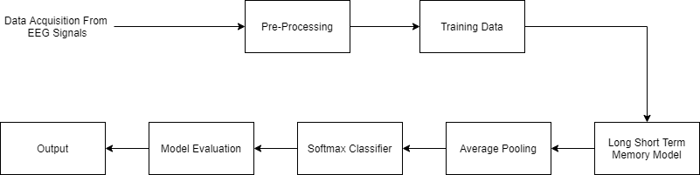

Slide 9
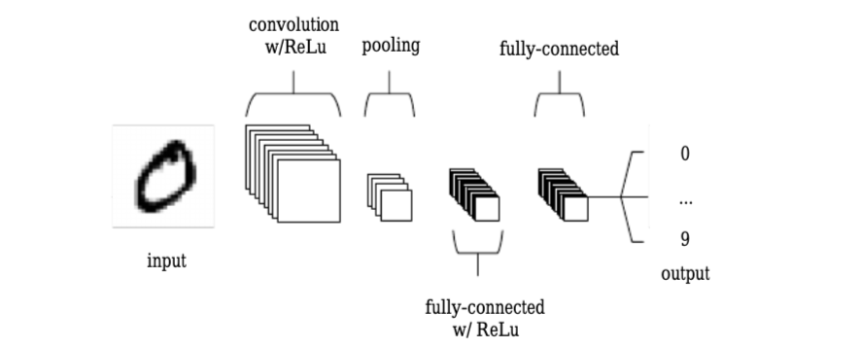

Slide 10
Use Case Diagram

Slide 11
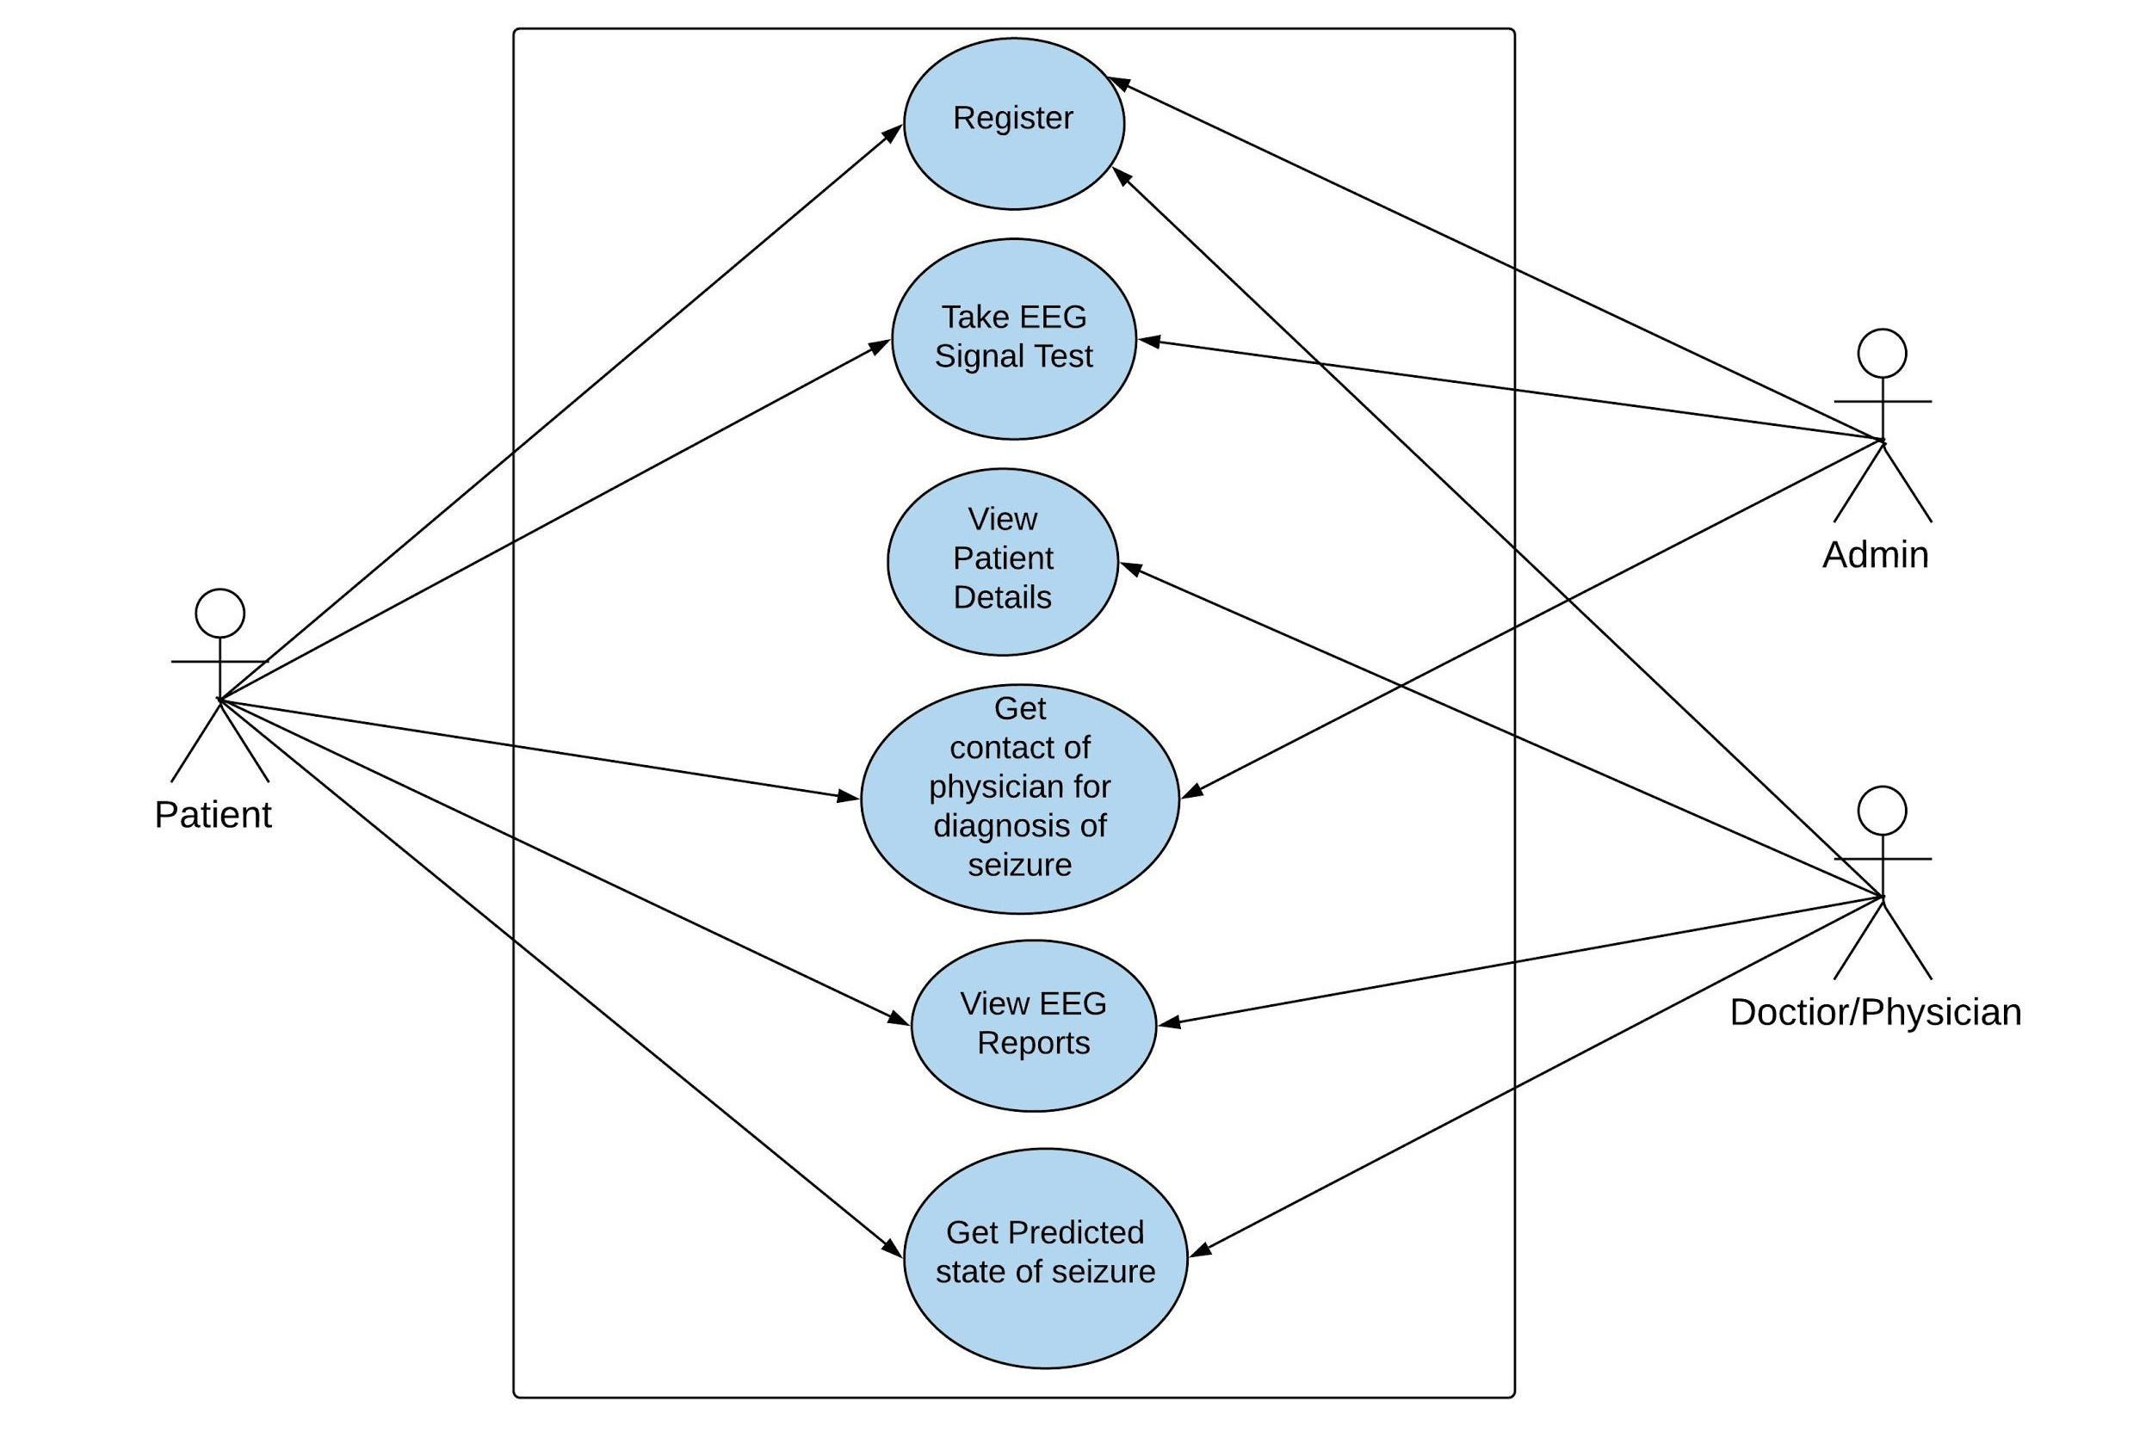

Slide 12
Technology Stack

Slide 13
Technology Stack
Front-End-GUI TKinter,Matplotlib
Programming Language-Python
Keras-Tensorflow

Slide 14
Timeline

Slide 15
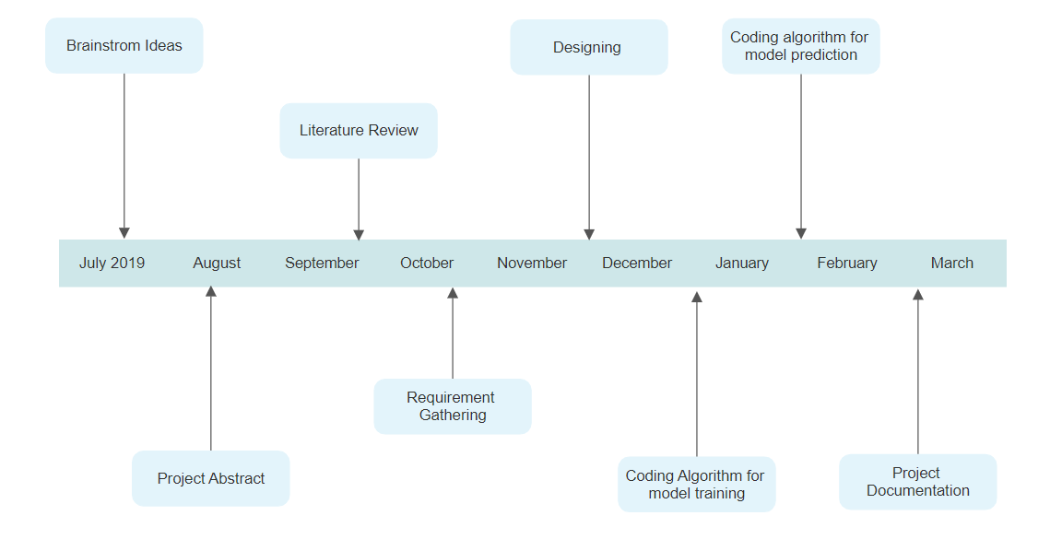
Timeline Chart

Slide 16
LSTM
Loss While Training | 0.079
Accuracy | 0.97
F1 Score | 0.97
Recall | 0.95
Precision | 0.98

Slide 17
CNN
Loss | 0.08
Accuracy | 0.95
F1 Score | 0.95
Precision | 0.95
Recall | 0.95

Slide 18
Conclusion
A deep learning approach has been used to detect epileptic seizures. It can successfully differentiate between the normal and seizure state of EEG. It can gain useful information out of noise which may be present in the data. The results prove the superiority of the proposed method over traditional methods.

Slide 19
Literature Survey
M. D’Alessandro, R. Esteller, G. Vachtsevanos, A. Hinson, J. Echauz and B. Litt, ”Epileptic seizure prediction using hybrid feature selection over multiple intracranial EEG electrode contacts: a report of four patients, in” IEEE Transactions on Biomedical Engineering, vol. 50, no. 5, pp. 603-615, May 2003.
L. D. Iasemidis et al., ”Adaptive epileptic seizure prediction system, in” IEEE Transactions on Biomedical Engineering,vol. 50, no. 5, pp.
616-627, May 2003.

Slide 20
S. Li, W. Zhou, Q. Yuan and Y. Liu, ”Seizure Prediction Using Spike Rate of Intracranial EEG, in ” IEEE Transactions on Neural Systems and Rehabilitation Engineering, vol.21, no. 6, pp. 880-886, Nov. 2013.
N. Wang and M. R. Lyu, ”Extracting and Selecting Distinctive EEG Features for Efficient Epileptic Seizure Prediction, in” IEEE Journal of Biomedical and Health Informatics,vol. 19, no. 5, pp. 1648-1659, Sept. 2015.

Slide 21
Thank You

